Slide 1
Demand Side Load Management using Machine Learning

Slide 2
Table of Contents
Definition
Objectives
Project Overview
Cyber-physical Systems
Environment Modelling
Work Flow Diagram
Block Diagram
Random Forest Algorithm
Prediction Record
Login Page
Signup
Appliance Record
Admin Page
Consumer Page
Priority Algorithm
Hardware Sketch
Design Specification
Operation
Hardware
Conclusion
Reference

Slide 3
Definition
Energy demand management, also known as demand-side management (DSM) or demand-side response (DSR), is the modification of consumer demand for energy through various methods such as financial incentives and behavioural change through education. Usually, the goal of demand-side management is to encourage the consumer to use less energy during peak hours, or to move the time of energy use to off-peak times such as night-time and weekends.

Slide 4
Objective
Study the power consumption pattern for a household and using suitable machine learning algorithm, forecast the load demand for future dates.
Study the power generation pattern from wind and solar plants, and using suitable machine learning algorithm, predict generation curve for future dates.
Encourage consumers to reduce energy consumption during peak hours, with the help of priority-based system.
Smooth out the load-time curve.
Reducing the monthly power bill.

Slide 5
Project Overview
Concepts of Machine Learning like Random Forest algorithm is being used to predict future generation and consumption pattern.
A website was created to monitor consumers’ appliance record and present forecasted data to consumers’ and system operators’.
A priority-based system has been developed, to reduce power consumption during peak hours and shift the use of heavy loads to off-peak hours, and has been implemented in the website.
All the information are send to a micro-controller which uses pre-coded algorithms to operate relays, thereby providing power to run suitable appliances.

Slide 6
Cyber-physical Systems
Our focus has been to integrate cyber physical systems in power distribution, where cyber physical systems are integrations of computation, networking, and physical processes. Embedded computers and networks, monitor and control the physical processes. This can help us achieve balance between generation and consumption at peak hours in micro-grid system.

Slide 7
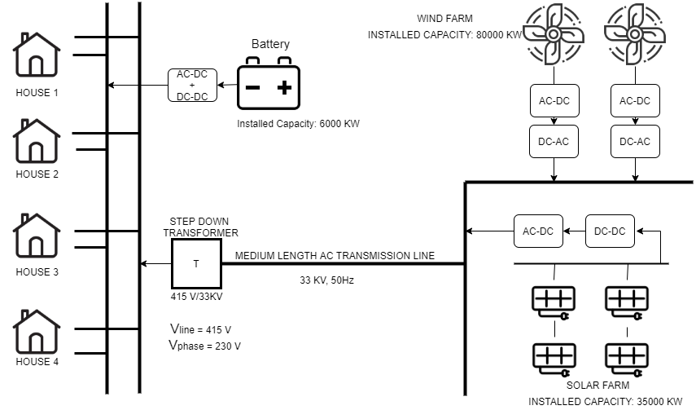
Environment Modelling

Slide 8










Work Flow Diagram
Loads
Generation
Admin
Controller
Webpage
User

Slide 9
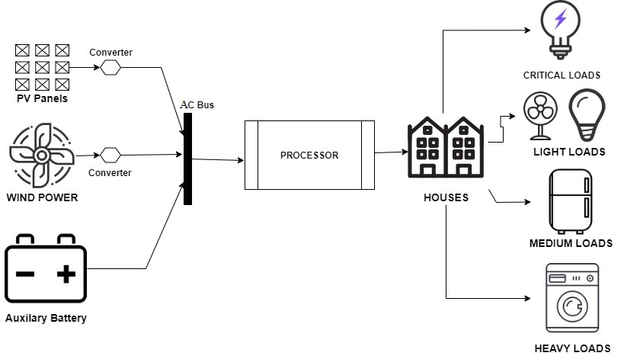
Block Diagram

Slide 10

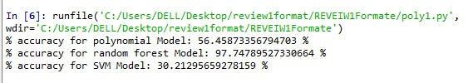
Random Forest Algorithm
It is a collection of decision tree algorithms running together on a given dataset. Basically a decision tree splits the given dataset into margins and decides the position of the predicted value based on the split data.

Slide 11
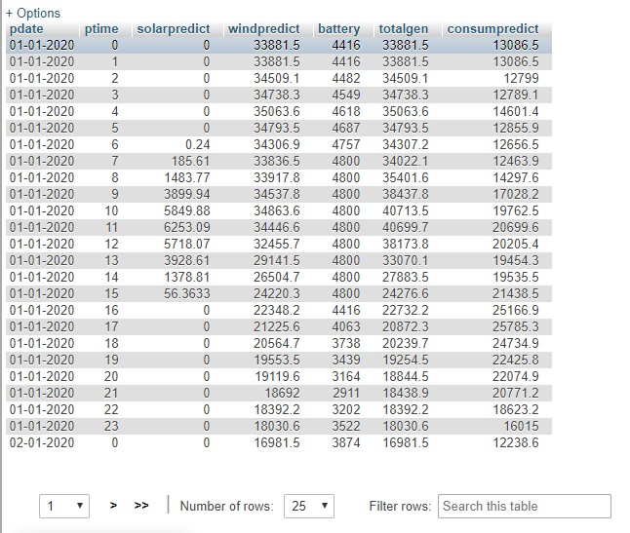
Prediction Record
This table consists of the predicted generation, consumption and the power available in the battery; over a period of year. This is the data we receive after running our prediction algorithm.

Slide 12

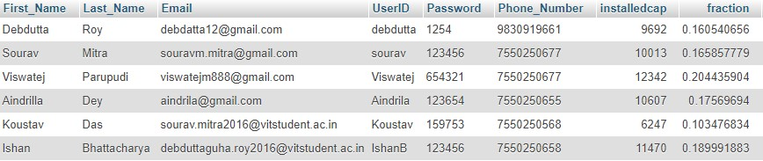
Login Page
The consumer enters data into the userid and password fields respectively. The values are cross checked with the data in userdata table and if matches, the user is allowed to login to their account.
Additional options like signup for new users and admin login are also available in this page.

Slide 13
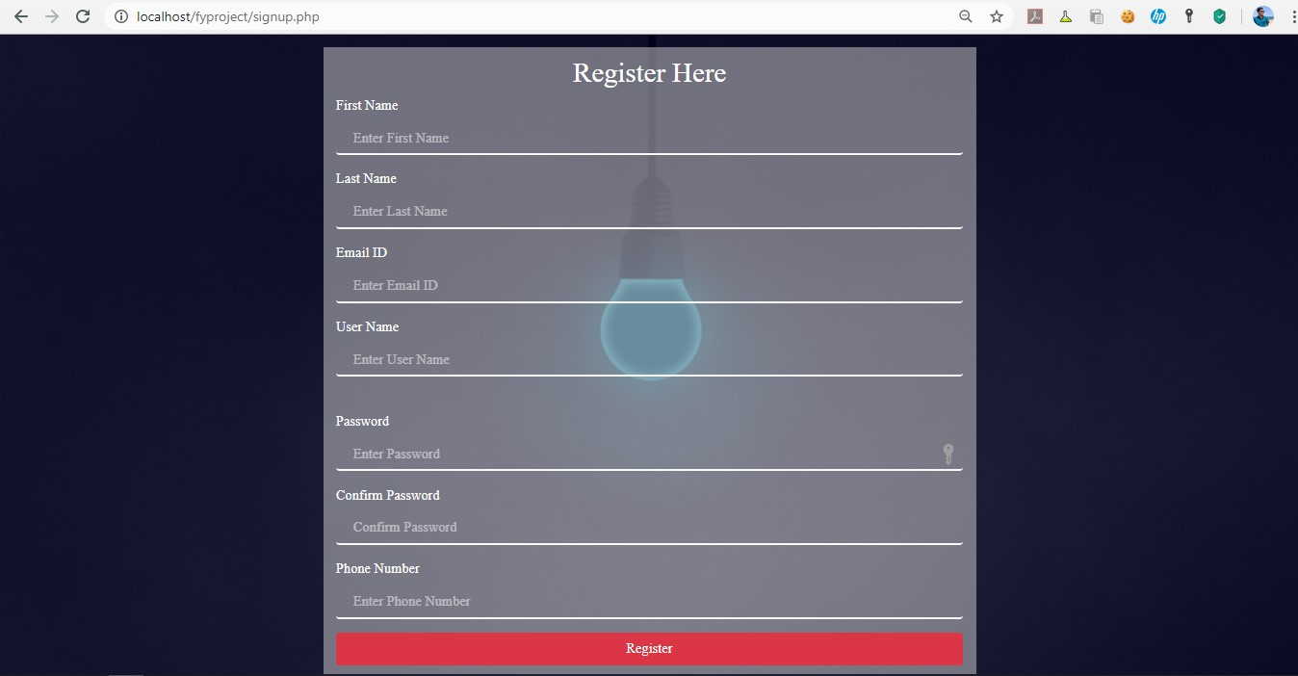
Signup
This page accepts the required credentials from a new consumer like name, email, UserID, and password. It has built-in functions in the background to check that the entered UserID is unique and doesn’t coincide anyone else registered with the system, and also checks that the password entered matches by confirming it.

Slide 14
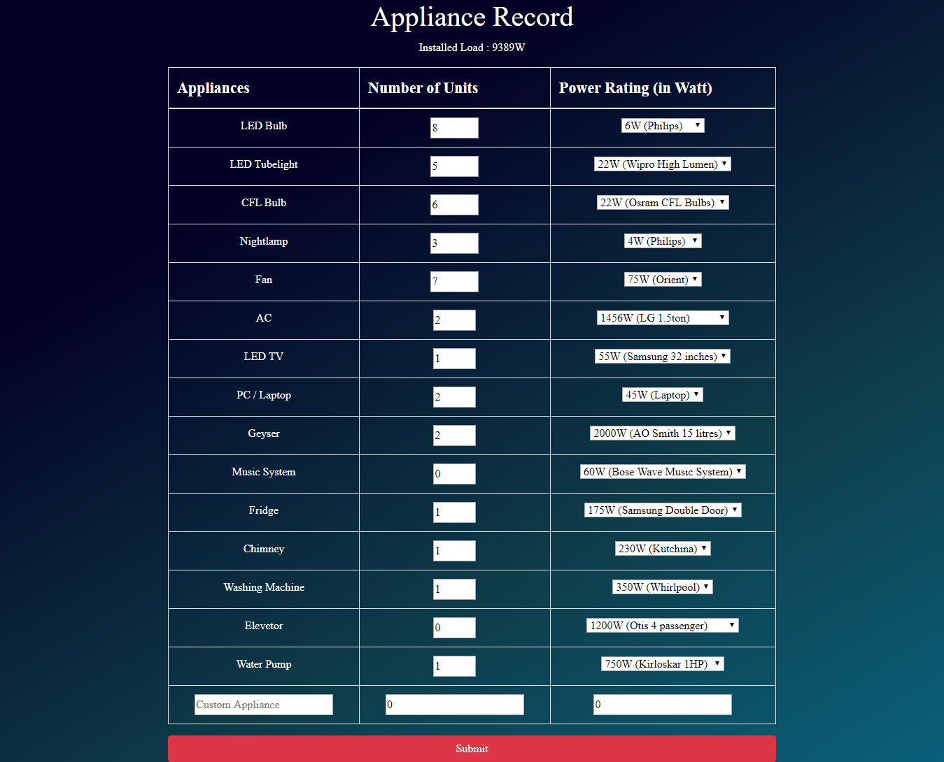
Appliance Record
Following the user registration the consumer needs to enter the appliances connected to his/her house in the website. A pre-defined set of appliances is already present. The consumer needs to enter the number of units and choose the rating of these appliances. As the user does so, the installed capacity is dynamically updated and shown to the user at the top of the screen. On clicking submit these data’s are stored in the database against the UserID of that consumer.

Slide 15
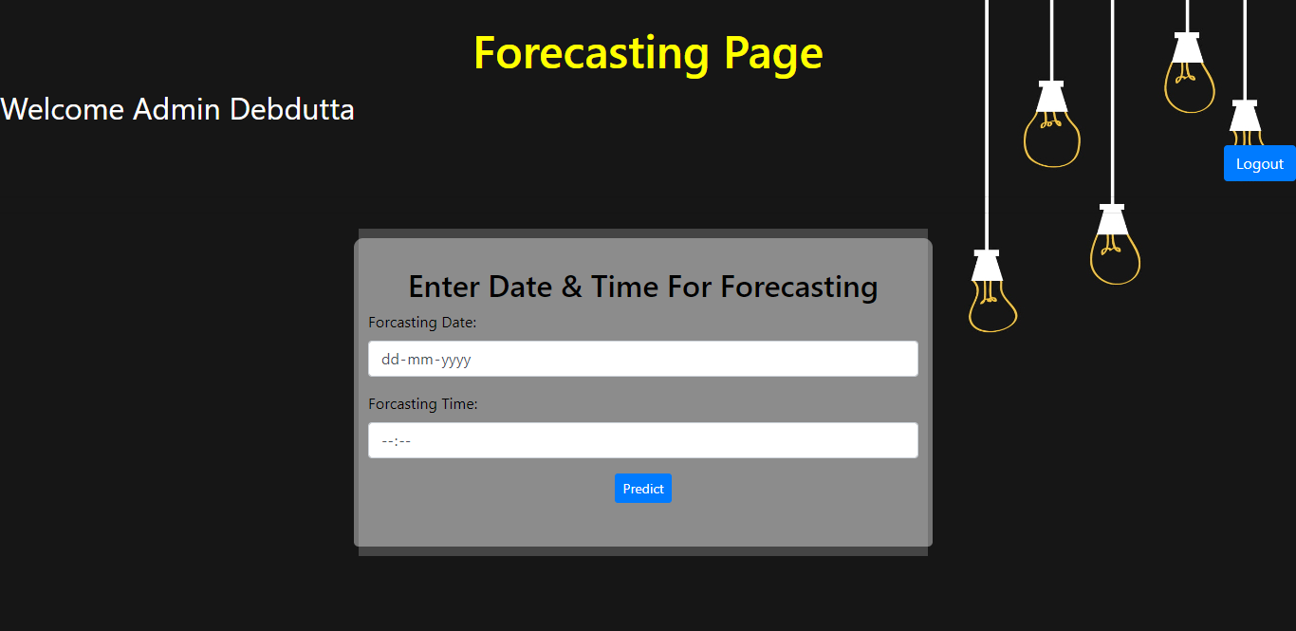
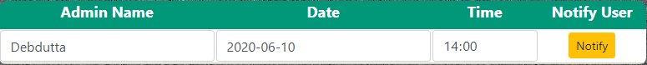
Admin Page
The admin logs in a day ahead and checks the peak and off-peak hours. He/She finds out during what time of the day there will be power deficit and the priority system is needed.
This is used to notify all consumers via mail the time of the day when their will be a power deficit.

Slide 16
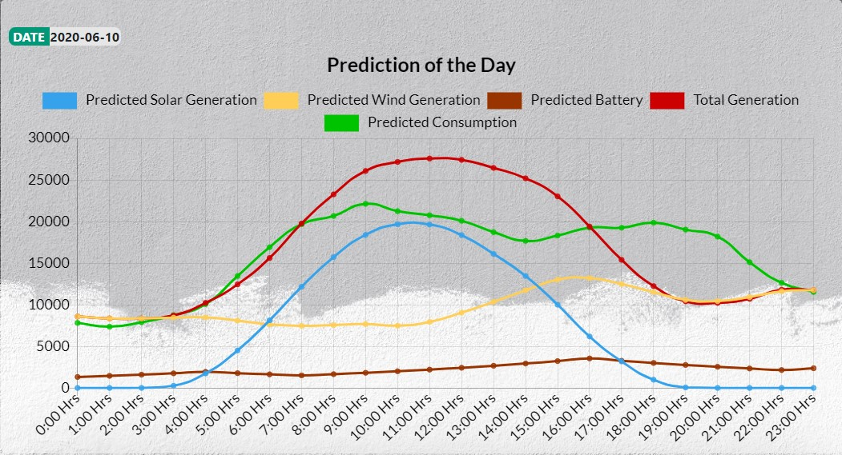
…continued
The graph shows the generation and consumption pattern of the entire day, which is analysed by the system operator, and used to notify the consumers the time of the day for which they need to assign priority to their appliances.

Slide 17
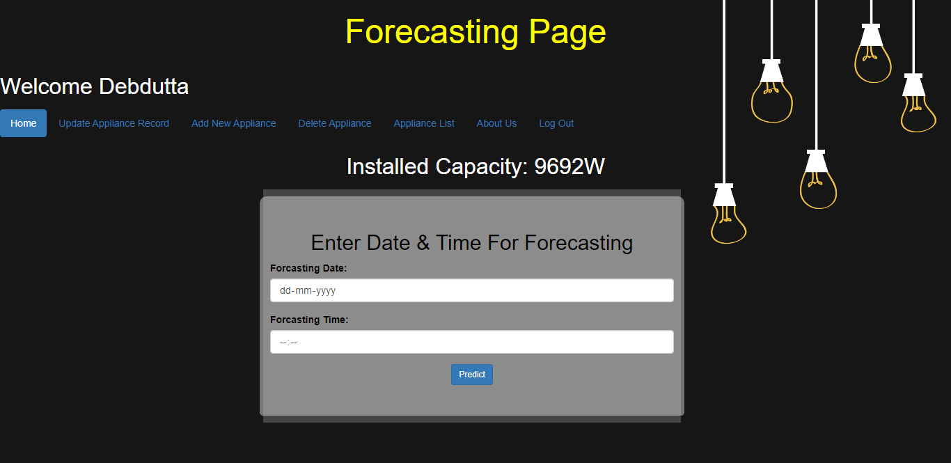
Consumer Page
This is the main page where a user lands once he/she logs in.
The consumer enters the date and time as notified by the operator to view the amount of power allotted by the operator to run the appliances.
Other options like updating existing loads, adding new appliances, deleting registered appliances, and appliance list have been provided.

Slide 18
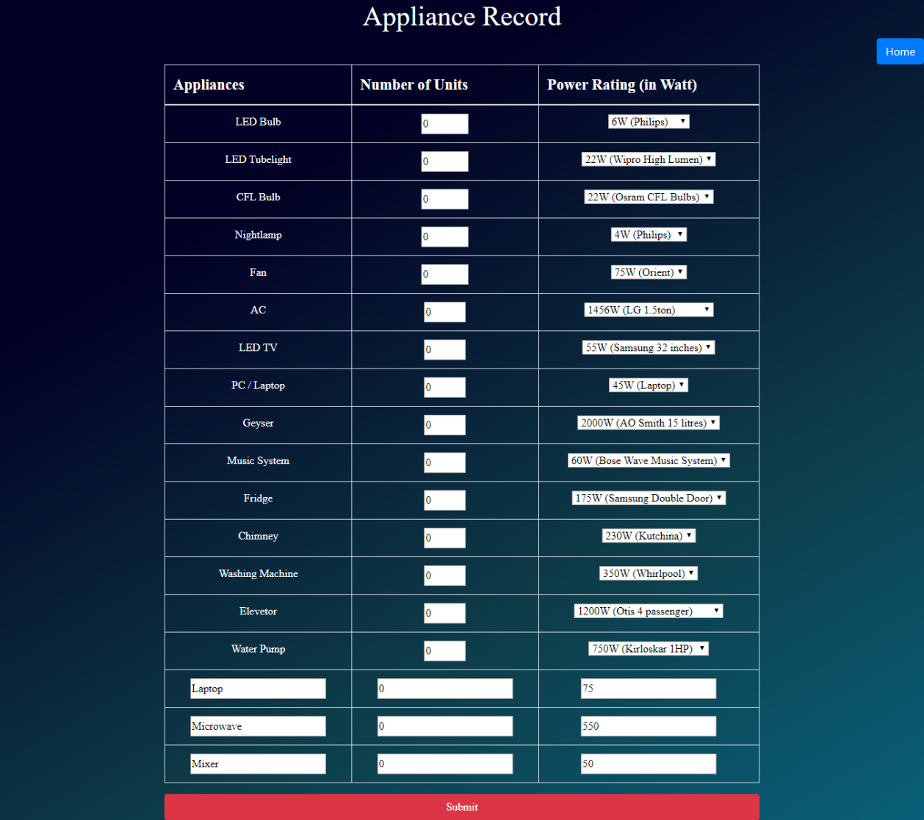
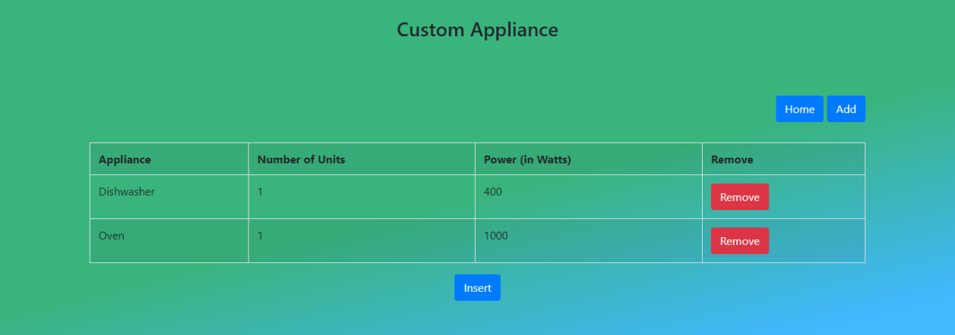
…continued
This webpage displays a set of appliances the user has already registered and provides the user with options to make modifications in the number of appliances and power rating of these appliances.
This webpage is used to add new appliances that are not present amongst the predefined set of appliances. The user has the option of entering the name, the number of units and the power rating of the appliances.

Slide 19
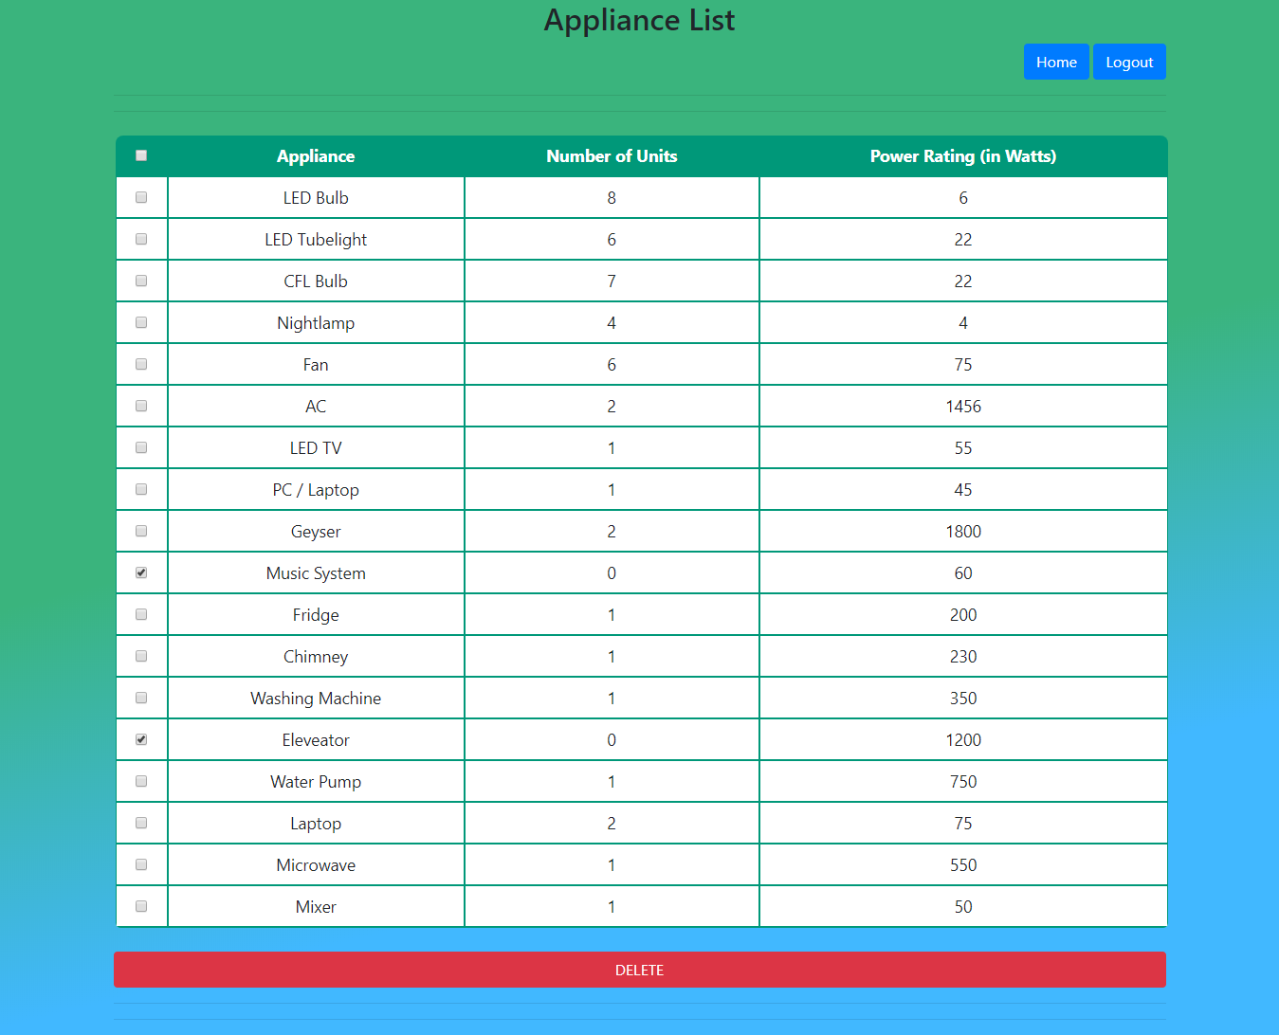
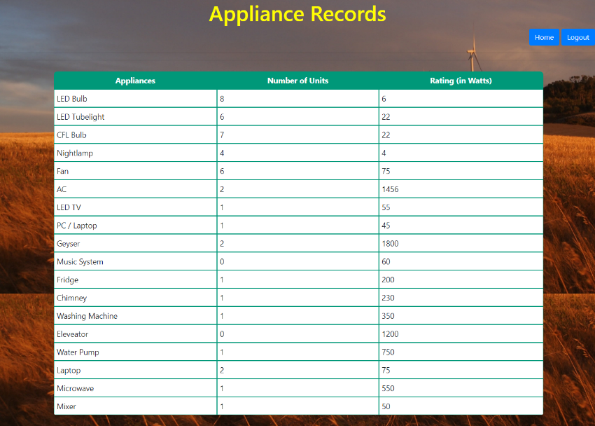
…continued
Shows a list of all registered appliances.
Used to delete multiple registered appliances.

Slide 20
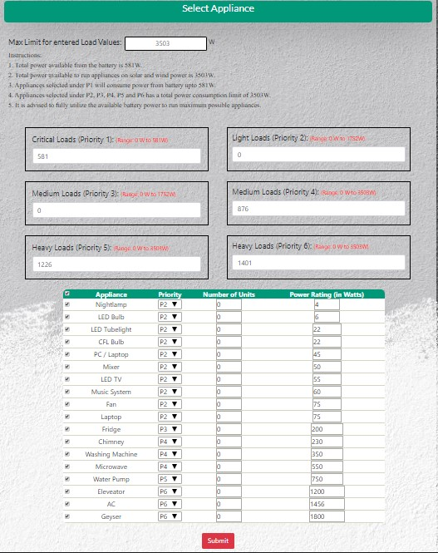
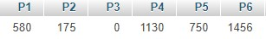
Priority Algorithm
Once the user gets in with the date and time specified in the mail, the consumer can see the amount of power he/she can consume. The consumer can choose from between six priorities 1-6. P1 signifies critical loads that are run on battery, P2-P6 are loads that consume power from the grid (wind + solar). An appliance selected under a specified priority cannot be changed until the next hour.
Once the user has selected the appliances, their priority, number of units and rating of the appliance, calculations are made in the background and the values under selected priority is updated. After the available power has been allotted, the user can submit these value which gets updated in the database. All the users having submitted the power consumption under each priority, it is updated in the database and is made available to the system admin.

Slide 21
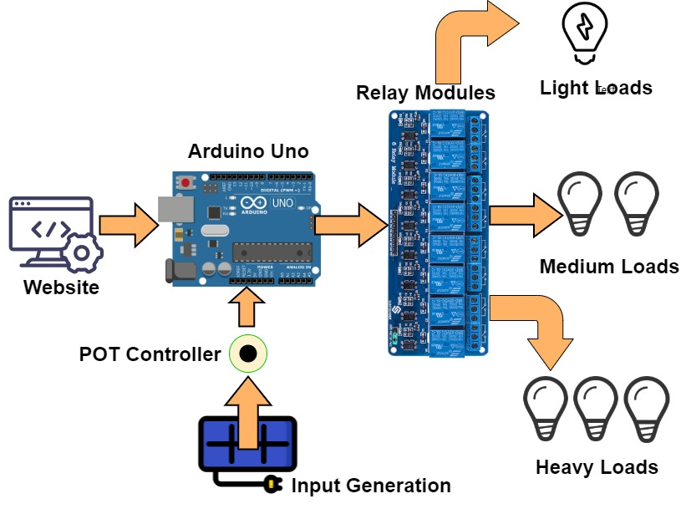
Hardware Sketch

Slide 22
Design Specification
Component | Specification
Battery | Volt: 9V Type: Zinc Carbon
Arduino Uno (ATmega328p) | Power: 9V/USB Pins: 14 digital, 2 analog
8 Channel-Relay Board | Power: 5V Operating Condition: 10A AC 250V / DC 30V
Potentiometer | Resistance: 10k Rated Power: 0.5W

Slide 23
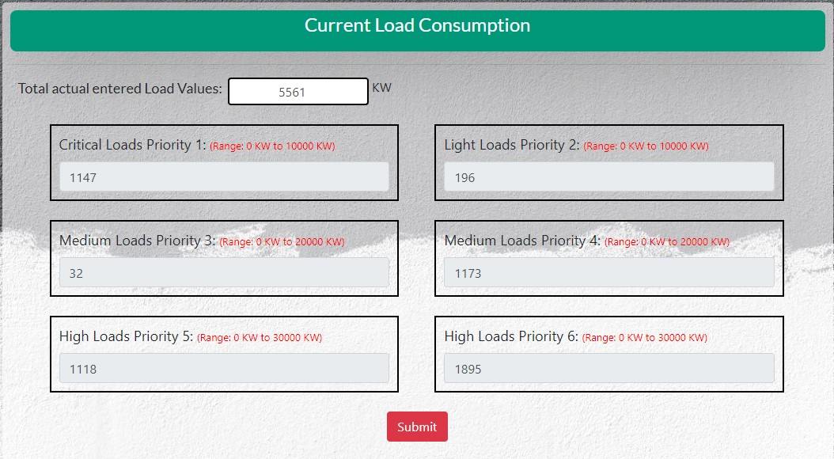
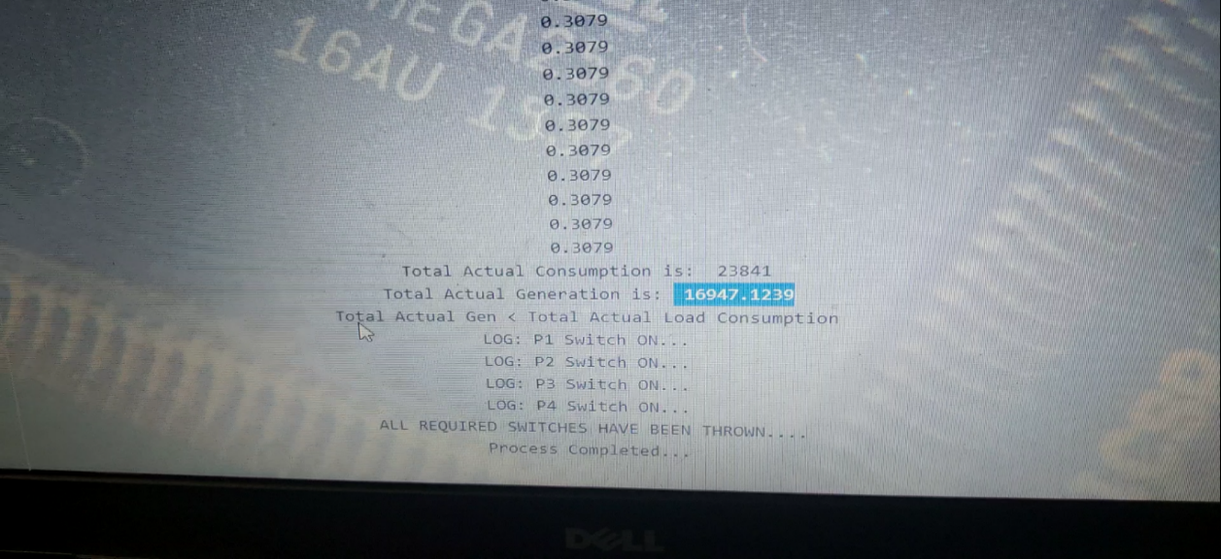
Operation
The system operator receives the combined values, from P1-P6, for all users connected to the grid. Once he/she submits these the values are send to the microcontroller.
The microcontroller reads these values and also reads the real-time generation value. As per built-in algorithm, the microcontroller turns ON and OFF the required relay ports and supply power to the appliances connected to them.

Slide 24
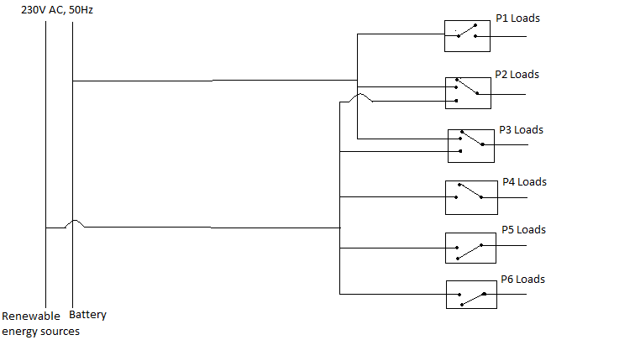
Hardware

Slide 25
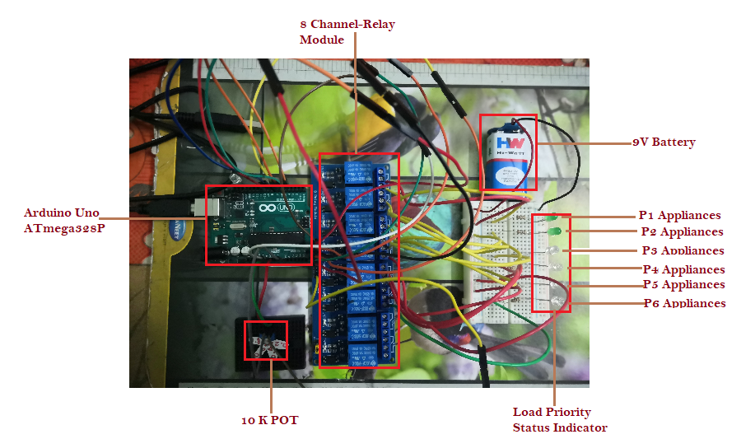

Slide 26
Conclusion
The Cyber physical system consisting the website will provide a user friendly interface for both the controlling authorities and the users for proper monitoring of the generation and consumption curves. An algorithm included in the web service platform will be controlling all the major relays for the power supply at the demand side. The whole system will can keep track of the users loads priorities as well as can control the operation of the relays to manage power flow during a power outage scenario i.e. when the main grid is unable to supply and hence working in islanded mode or during the period when the total consumption is more than the total generation.

Slide 27
Reference
Cemal Keles, Baris Baykant Alagoz, Asim Kaygusuz, A Note On Demand Side Load Management by Maximum Power Limited Load Shedding Algorithm For Smart Grids, 2015 3rd International Istanbul Smart Grid Congress and Fair (ICSG), Pages 18-23.
Vinod Namboodiri, Visvakumar Aravinthan, Surya Narayan Mohapatra, Babak Karimi and Ward Jewell, Toward a Secure Wireless-Based Home Area Network for Metering in Smart Grids, IEEE SYSTEMS JOURNAL, VOL. 8, NO. 2, JUNE 2014, Pages 509-520
C.M. Lin and M.T. Chen, Design and Implementation of a Smart Home Energy Saving System with Active Loading Feature Identification and Power Management, 2017 IEEE 3rd International Future Energy Electronics Conference and ECCE Asia (IFEEC 2017 - ECCE Asia), Pages 739-742.
Lekshmi. M and Adithya Subramanya K. N, Short-Term Load Forecasting of 400kV Grid Substation Using R-Tool and Study of Influence of Ambient Temperature on the Forecasted Load, 2019 Second International Conference on Advanced Computational and Communication Paradigms (ICACCP), Pages 635-639.

Slide 28
…continued
A.K. Srivastava1, Ajay Shekhar Pandey and Devender Singh, Short-Term Load Forecasting Methods: A Review, International Conference on Emerging Trends in Electrical, Electronics and Sustainable Energy Systems (ICETEESES–16), Pages 1-9.
C. Vaithilingam, R.P. Kumudini Devi and K Elango, Available transfer capability estimation using Support Vector Machine, International Journal of Electrical Power & Energy Systems(2013) ,Volume 47, Pages 387-393
C. Sandels, J. Widén, L. Nordström, Forecasting household consumer electricity load profiles with a combined physical and behavioural approach, Applied Energy by Elsevier Ltd (2014), Volume 131, Page 267-278.
Md. Moktadir Rahman, Sujeewa Hettiwatte, Samuel Gyamfi, An Intelligent Approach of Achieving Demand Response by Fuzzy Logic based Domestic Load Management, 2014 Australasian Universities Power Engineering Conference (AUPEC), Pages 811-816.
Piers R. J. Campbell, and Ken Adamson, Methodologies for Load Forecasting, 2006 3rd International IEEE Conference Intelligent Systems, Pages 800- 806.

Slide 29
Thank You

